Slide 1

Weeks 7 & 8 Transport layer – part II
Computer Networking: A Top-Down Approach 8th Edition, Global Edition Jim Kurose, Keith Ross Copyright © 2022 Pearson Education Ltd

Slide 2
TCP: overview RFCs: 793,1122, 2018, 5681, 7323
“logical” point-to-point:
one sender, one receiver
reliable, in-order byte stream:
no “message boundaries"
full duplex data:
bi-directional data flow in same connection
MSS: maximum segment size
cumulative ACKs
pipelining:
TCP congestion and flow control set window size
connection-oriented:
handshaking (exchange of control messages) initializes sender, receiver state before data exchange
flow controlled:
sender will not overwhelm receiver

Slide 3
TCP segment structure
32 bits
source port #
dest port #
segment seq #: counting bytes of data into bytestream (not segments!)
ACK: seq # of next expected byte; A bit: this is an ACK
sequence number
acknowledgement number
length (of TCP header)
head
len
not
used
A
P
S
receive window
flow control: # bytes receiver willing to accept
C
E
U
R
F
Internet checksum
checksum
Urg data pointer
options (variable length)
C, E: congestion notification
TCP options
application
data
(variable length)
data sent by application into TCP socket
RST, SYN, FIN: connection management

Slide 4
TCP sequence numbers, ACKs
outgoing segment from sender
Sequence numbers:
byte stream “number” of first byte in segment’s data
source port #
dest port #
sequence number
acknowledgement number
rwnd
checksum
urg pointer
window size
N
Acknowledgements:
seq # of next byte expected from other side
cumulative ACK
sender sequence number space
sent
ACKed
sent, not-yet ACKed
(“in-flight”)
usable
but not
yet sent
not
usable
Q: how receiver handles out-of-order segments
A: TCP spec doesn’t say, - up to implementor
outgoing segment from receiver
source port #
dest port #
sequence number
acknowledgement number
A
rwnd
checksum
urg pointer

Slide 5

TCP sequence numbers, ACKs
Host A
Host B
User types‘C’
Seq=42, ACK=79, data = ‘C’
host ACKs receipt of‘C’, echoes back ‘C’
Seq=79, ACK=43, data = ‘C’
host ACKs receipt of echoed ‘C’
Seq=43, ACK=80
simple telnet scenario
Notes:
The key thing to note here is that the ACK number (43) on the B-to-A segment is one more than the sequence number (42) on the A-toB segment that triggered that ACK
Similarly, the ACK number (80) on the last A-to-B segment is one more than the sequence number (79) on the B-to-A segment that triggered that ACK

Slide 6
TCP round trip time, timeout
Q: how to set TCP timeout value?
longer than RTT, but RTT varies!
too short: premature timeout, unnecessary retransmissions
too long: slow reaction to segment loss
Q: how to estimate RTT?
measure time from segment transmission until ACK receipt
ignore retransmissions
average several recent measurements
Notes:
This is how TCP re-computes the estimated RTT each time a new SampleRTT is taken.
The process is knows as an exponeitally weighted moving average, shown by the equation here.
<say it>
Where alpha reflects the influence of the most recent measurements on the estimated RTT; a typical value of alpha used in implementaitons is .125
The graph at the bottom show measured RTTs beween a host in the Massachusetts and a host in France, as well as the estimated, “smoothed” RTT
Given this value of the estimated RTT, TCP computes the timeout interval to be the estimated RTT plus a “safety margin”
And the intuition is that if we are seeing a large variation in SAMPLERTT – the RTT estimates are fluctuating a lot - then we’ll want a larger savety margin
So TCP computes the Timeout interval to be the Estimated RTT plus 4 times a measure of deviation in the RTT.
The deviation in the RTT is computed as the eWMA of the difference between the most recently measured SampleRTT from the Estimated RTT

Slide 7
TCP Sender (simplified)
event: data received from application
create segment with seq #
seq # is byte-stream number of first data byte in segment
start timer if not already running
think of timer as for oldest unACKed segment
event: timeout
retransmit segment that caused timeout
restart timer
event: ACK received
if ACK acknowledges previously unACKed segments
update what is known to be ACKed
start timer if there are still unACKed segments
Notes:
Given these details of TCP sequence numbers, acks, and timers, we can now describe the big picture view of how the TCP sender and receiver operate
You can check out FSMs in book; let’s just give an English text description here and let’s start with the sender.
Rather than immediately ACKnowledig this segment, many TCP implementations will wait for half a second for another in-order segment to arrive, and then generate a single cumulative ACK for both segments – thus decreasing the amount of ACK traffic. The arrival of this second in-order segment and the cumulative ACK generation that covers both segments is the second row in this table.

Slide 8
TCP: retransmission scenarios
Host A
Host B
Host A
Host B
SendBase=92
Seq=92, 8 bytes of data
Seq=92, 8 bytes of data
timeout
timeout
Seq=100, 20 bytes of data
ACK=100
X
ACK=100
ACK=120
Seq=92, 8 bytes of data
Seq=92, 8
bytes of data
SendBase=100
send cumulative
ACK for 120
SendBase=120
ACK=100
ACK=120
SendBase=120
lost ACK scenario
premature timeout
Notes:
To cement our understanding of TCP reliability, let’s look a a few retransmission scenarios
In the first case a TCP segments is transmited and the ACK is lost, and the TCP timeout mechanism results in another copy of being transmitted and then re-ACKed a the sender
In the second example two segments are sent and acknowledged, but there is a premature timeout e for the first segment, which is retransmitted. Notet that when this retransmitted segment is received, the receiver has already received the first two segments, and so resends a cumulative ACK for both segments received so far, rather than an ACK for just this fist segment.

Slide 9
TCP: retransmission scenarios
Host A
Host B
Seq=92, 8 bytes of data
Seq=100, 20 bytes of data
ACK=100
X
ACK=120
Seq=120, 15 bytes of data
cumulative ACK covers for earlier lost ACK
Notes:
And in this last example, two segments are again transmitted, the first ACK is lost but the second ACK, a cumulative ACK arrives at the sender, which then can transmit a third segment, knowing that the first two have arrived, even though the ACK for the first segment was lost

Slide 10
TCP flow control
Q: What happens if network layer delivers data faster than application layer removes data from socket buffers?
application
process
Application removing data from TCP socket buffers
TCP socket
receiver buffers
receive window
flow control: # bytes receiver willing to accept
TCP
code
Network layer delivering IP datagram payload into TCP socket buffers
IP
code
flow control
receiver controls sender, so sender won’t overflow receiver’s buffer by transmitting too much, too fast
from sender
from sender
receiver protocol stack
Notes:
(Presuming an intro)
Before diving into the details of TCP flow control, let’s first get the general context and motivate the need for flow control.
This diagram show a typical transport-layer implementation
A segment is brought up the protocol stack to the transport layer, and the segment’s payload is removed from the segment and written INTO socket buffers.
How does data get taken OUT of socket buffers? By applications performing socket reads, as we learned in Chapter 2.
And so the question is “What happens if network layer delivers data faster than an application-layer process removes data from socket buffers?”
Let’s watch a video of what happens when things arrive way too fast to fast to be processed.
<video>. (I love that video). Another human analogy showing the need for flow control is the saying – to use some English slang - “no one can drink from a firehose”
Flow control is a mechanism to the calamity of a receiver being over-run by a sender that is sending too fast – it allows the RECEIVER to explictly control the SENDER so sender won’t overflow receiver’s buffer by transmitting too much, too fast

Slide 11
TCP flow control
TCP receiver “advertises” free buffer space in rwnd (Receive Window) field in TCP header
RcvBuffer (an internal buffer on the receiver's system where the received data is stored.
many operating systems autoadjust RcvBuffer
sender limits amount of unACKed (“in-flight”) data to received rwnd
guarantees receive buffer will not overflow
to application process
RcvBuffer
buffered data
rwnd
free buffer space
TCP segment payloads
TCP receiver-side buffering
Notes:
Here’s how TCP implement flow control. The basic idea is simple – the receiver informs the sender how much free buffer space there is, and the sender is limited to send no more than this amount of data. That the value o RWND in the diagram to the right.
This information is carried from the receiver to the sender in the “receiver advertised window” (do a PIP of header) in the TCP header, and the value will change as the amount of free buffer space fluctuates over time.

Slide 12
TCP flow control
flow control: # bytes receiver willing to accept
TCP receiver “advertises” free buffer space in rwnd field in TCP header
RcvBuffer size set via socket options (typical default is 4096 bytes)
many operating systems autoadjust RcvBuffer
sender limits amount of unACKed (“in-flight”) data to received rwnd
guarantees receive buffer will not overflow
receive window
TCP segment format
Notes:
Here’s how TCP implement flow control. The basic idea is simple – the receiver informs the sender how much free buffer space there is, and the sender is limited to send no more than this amount of data. That the value o RWND in the diagram to the right.
This information is carried from the receiver to the sender in the “receiver advertised window” (do a PIP of header) in the TCP header, and the value will change as the amount of free buffer space fluctuates over time.

Slide 13
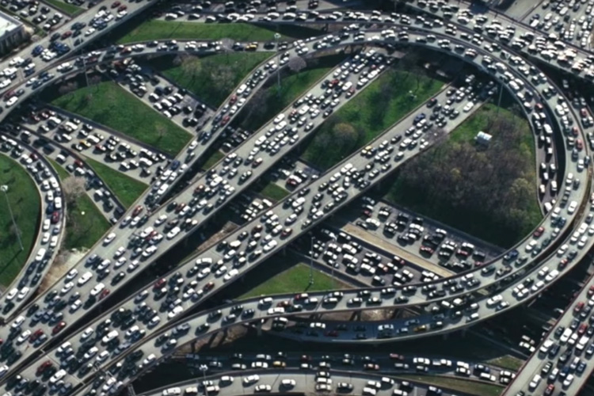


Principles of congestion control
Congestion:
informally: “too many sources sending too much data too fast for network to handle”
manifestations:
long delays (queueing in router buffers)
packet loss (buffer overflow at routers)
different from flow control!
congestion control: too many senders, sending too fast
a top-10 problem!
flow control: one sender too fast for one receiver

Slide 14
Causes/costs of congestion: scenario 1
original data: λ_{in}
throughput: λ_{out}
Simplest scenario:
Host A
one router, infinite buffers
input, output link capacity: R
infinite shared output link buffers
two flows
R
R
no retransmissions needed
Host B
R/2
Q: What happens as arrival rate λ_{in} approaches R/2?
λ_{out}
delay
throughput:
λ_{in}
R/2
λ_{in}
R/2
maximum per-connection throughput: R/2
large delays as arrival rate λ_{in} approaches capacity
R/2

Slide 15
Causes/costs of congestion: scenario 2
one router, finite buffers
sender retransmits lost, timed-out packet
application-layer input = application-layer output: λ_{in} = λ_{out}
transport-layer input includes retransmissions : λ’_{in} λ_{in}
Host A
λ_{in} : original data
λ'_{in}: original data, plus retransmitted data
λ_{out}
R
R
Host B
finite shared output link buffers

Slide 16
Causes/costs of congestion: scenario 2
Idealization: perfect knowledge
sender sends only when router buffers available
R/2
λ_{out}
throughput:
Host A
λ_{in} : original data
λ_{in}
copy
λ'_{in}: original data, plus retransmitted data
λ_{out}
R/2
free buffer space!
R
R
Host B
finite shared output link buffers

Slide 17

Causes/costs of congestion: scenario 2
Idealization: some perfect knowledge
packets can be lost (dropped at router) due to full buffers
sender knows when packet has been dropped: only resends if packet known to be lost
Host A
λ_{in} : original data
copy
λ'_{in}: original data, plus retransmitted data
no buffer space!
R
R
Host B
finite shared output link buffers

Slide 18
Causes/costs of congestion: scenario 2
Idealization: some perfect knowledge
packets can be lost (dropped at router) due to full buffers
sender knows when packet has been dropped: only resends if packet known to be lost
R/2
λ_{out}
“wasted” capacity due to retransmissions
when sending at R/2, some packets are needed retransmissions
throughput:
Host A
λ_{in} : original data
λ_{in}
λ'_{in}: original data, plus retransmitted data
R/2
free buffer space!
R
R
Host B
finite shared output link buffers

Slide 19


Causes/costs of congestion: scenario 2
Realistic scenario: un-needed duplicates
packets can be lost, dropped at router due to full buffers – requiring retransmissions
but sender times can time out prematurely, sending two copies, both of which are delivered
R/2
λ_{out}
“wasted” capacity due to un-needed retransmissions
throughput:
when sending at R/2, some packets are retransmissions, including needed and un-needed duplicates, that are delivered!
Host A
λ_{in} : original data
λ_{in}
copy
λ'_{in}: original data, plus retransmitted data
R/2
timeout
free buffer space!
R
R
Host B
finite shared output link buffers

Slide 20
Causes/costs of congestion: scenario 2
Realistic scenario: un-needed duplicates
packets can be lost, dropped at router due to full buffers – requiring retransmissions
but sender times can time out prematurely, sending two copies, both of which are delivered
R/2
λ_{out}
“wasted” capacity due to un-needed retransmissions
throughput:
when sending at R/2, some packets are retransmissions, including needed and un-needed duplicates, that are delivered!
λ_{in}
R/2
“costs” of congestion:
more work (retransmission) for given receiver throughput
unneeded retransmissions: link carries multiple copies of a packet
decreasing maximum achievable throughput

Slide 21
Approaches towards congestion control
End-end congestion control:
no explicit feedback from network
congestion inferred from observed loss, delay
ACKs
data
data
ACKs
approach taken by TCP

Slide 22
Approaches towards congestion control
Network-assisted congestion control:
routers provide direct feedback to sending/receiving hosts with flows passing through congested router
may indicate congestion level or explicitly set sending rate
explicit congestion info
ACKs
data
data
ACKs
TCP ECN, ATM, DECbit protocols

Slide 23
TCP congestion control: AIMD
approach: senders can increase sending rate until packet loss (congestion) occurs, then decrease sending rate on loss event
Additive Increase
Multiplicative Decrease
increase sending rate by 1 maximum segment size every RTT until loss detected
cut sending rate in half at each loss event
AIMD sawtooth
behavior: probing
for bandwidth
TCP sender Sending rate
time

Slide 24
TCP AIMD: more
Multiplicative decrease detail: sending rate is
Cut in half on loss detected by triple duplicate ACK (TCP Reno)
Cut to 1 MSS (maximum segment size) when loss detected by timeout (TCP Tahoe)
Why AIMD?
AIMD – a distributed, asynchronous algorithm – has been shown to:
optimize congested flow rates network wide!
have desirable stability properties

Slide 25
TCP congestion control: details
sender sequence number space
TCP sending behavior:
roughly: send cwnd bytes, wait RTT for ACKS, then send more bytes
cwnd
last byte
ACKed
cwnd
sent, but not-yet ACKed
(“in-flight”)
available but not used
TCP rate
~
bytes/sec
~
RTT
last byte sent
TCP sender limits transmission:
cwnd is dynamically adjusted in response to observed network congestion (implementing TCP congestion control)
<
cwnd
LastByteSent- LastByteAcked

Slide 26
TCP slow start
Host A
Host B
when connection begins, increase rate exponentially until first loss event:
initially cwnd = 1 MSS
double cwnd every RTT
done by incrementing cwnd for every ACK received
one segment
RTT
two segments
four segments
summary: initial rate is slow, but ramps up exponentially fast
time

Slide 27
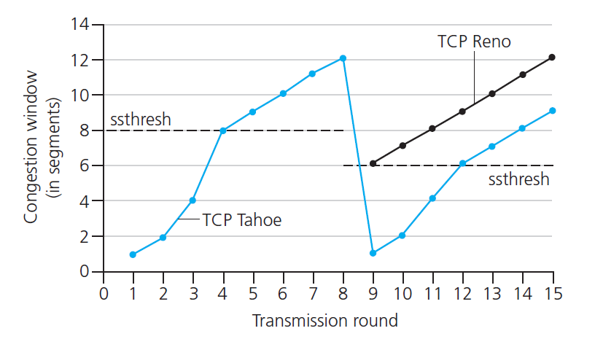

TCP: from slow start to congestion avoidance
Q: when should the exponential increase switch to linear?
A: when cwnd gets to 1/2 of its value before timeout.
X
Implementation:
variable ssthresh
on loss event, ssthresh is set to 1/2 of cwnd just before loss event
* Check out the online interactive exercises for more examples: http://gaia.cs.umass.edu/kurose_ross/interactive/

Slide 28
TCP and the congested “bottleneck link”
TCP (classic, CUBIC) increase TCP’s sending rate until packet loss occurs at some router’s output: the bottleneck link
understanding congestion: useful to focus on congested bottleneck link
insight: increasing TCP sending rate will not increase end-end throughout with congested bottleneck
source
destination
application
TCP
network
link
physical
application
TCP
network
link
physical
insight: increasing TCP sending rate will increase measured RTT
Goal: “keep the end-end pipe just full, but not fuller”
RTT

Slide 29
Delay-based TCP congestion control
Keeping sender-to-receiver pipe “just full enough, but no fuller”: keep bottleneck link busy transmitting, but avoid high delays/buffering
# bytes sent in last RTT interval
RTT_{measured}
measured
throughput
=
RTT_{measured}
Delay-based approach:
RTT_{min} - minimum observed RTT (uncongested path)
uncongested throughput with congestion window cwnd is cwnd/RTT_{min}
if measured throughput “very close” to uncongested throughput
increase cwnd linearly /* since path not congested */
else if measured throughput “far below” uncongested throughout
decrease cwnd linearly /* since path is congested */

Slide 30
Delay-based TCP congestion control
congestion control without inducing/forcing loss
maximizing throughout (“keeping the just pipe full… ”) while keeping delay low (“…but not fuller”)
a number of deployed TCPs take a delay-based approach
BBR deployed on Google’s (internal) backbone network

Slide 31
Explicit congestion notification (ECN)
TCP deployments often implement network-assisted congestion control:
two bits in IP header (ToS field) marked by network router to indicate congestion
policy to determine marking chosen by network operator
congestion indication carried to destination
destination sets ECE bit on ACK segment to notify sender of congestion
involves both IP (IP header ECN bit marking) and TCP (TCP header C,E bit marking)
source
TCP ACK segment
destination
application
TCP
network
link
physical
application
TCP
network
link
physical
ECE=1
ECN=10
ECN=11
IP datagram

